Slide 1
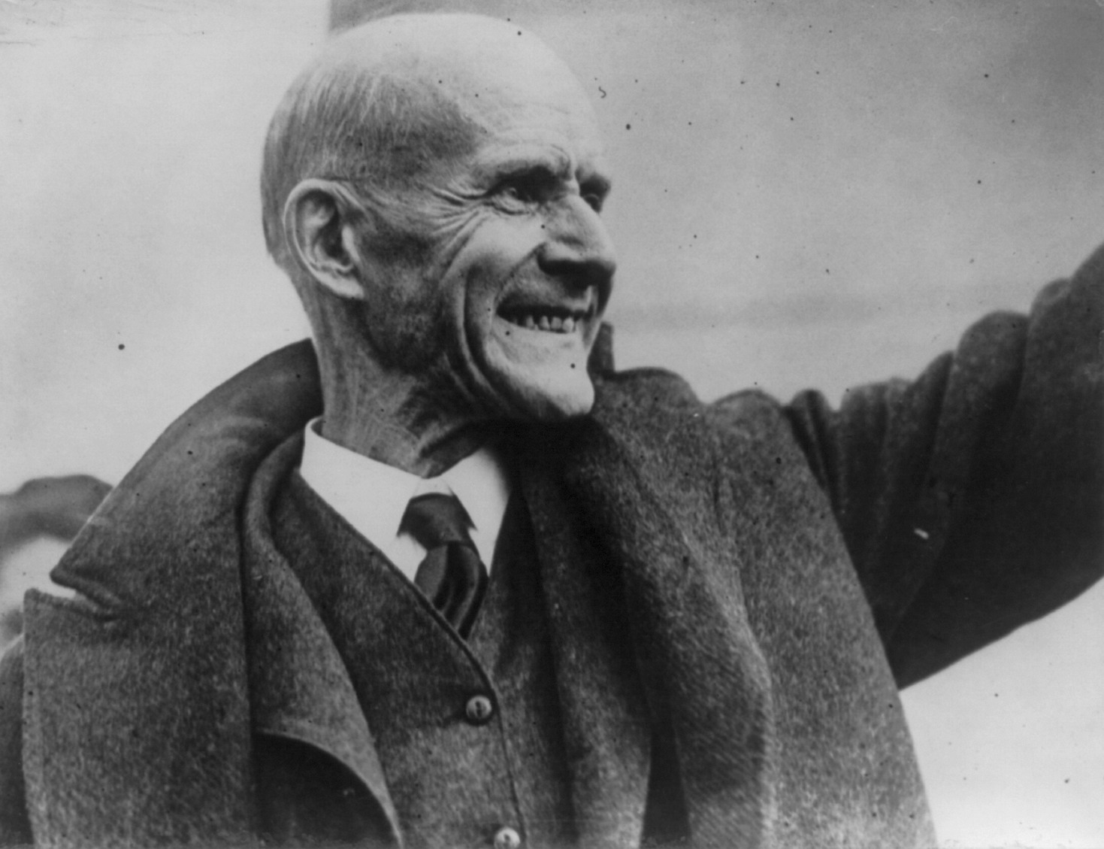
Notes:
Begin by asking students: What are some different reasons a person might oppose a war? The reasons might involve questions of the legality or morality of the war in question or of war in general, or reasons for opposition might be more personal.
During the Civil War, riots broke out in New York in response to a draft that was enacted in the Union in 1863. Eligible men aged 25 to 45 were compelled to serve unless they could pay $300 for a substitute. Much of the opposition expressed by the public was in response to the draft, and the opposition to the draft was closely related to the perception of status and power of working class white Americans (particularly Irish immigrants) in relation to the status of black Americans, who were exempt from service because they were not considered citizens but enjoyed some of the same freedoms as citizens in the Union.
During World War I, opponents of U.S. involvement focused on the inequities of the draft but also demanded protection of free speech, especially after the enactment of the Sedition and Espionage Acts. The Sedition Act of 1918 made it illegal to "willfully utter, print, write, or publish any disloyal, profane, scurrilous, or abusive language about the form of the Government of the United States" or to "willfully urge, incite, or advocate any curtailment of the production" of the things "necessary or essential to the prosecution of the war." Eugene Debs, pictured in slide 1, was a union leader and presidential candidate under the Socialist Party of America, who in 1918 delivered a speech in Canton, Ohio, that led to his arrest and imprisonment under the terms of the Sedition and Espionage Acts.

Slide 2
They have always taught and trained you to believe it to be your patriotic duty to go to war and to have yourselves slaughtered at their command. But in all the history of the world you, the people, have never had a voice in declaring war, and strange as it certainly appears, no war by any nation in any age has ever been declared by the people.
And here let me emphasize the fact—and it cannot be repeated too often—that the working class who fight all the battles, the working class who make the supreme sacrifices, the working class who freely shed their blood and furnish the corpses, have never yet had a voice in either declaring war or making peace. It is the ruling class that invariably does both. They alone declare war and they alone make peace.
Eugene V. Debs, Canton Speech, June 16, 1918
Notes:
Ask students to read the excerpt of Debs’ speech included on slide 2. Do you agree or disagree with Debs’ ideas about the nature of war? Do you think his words have relevance in the 21st century?

Slide 3
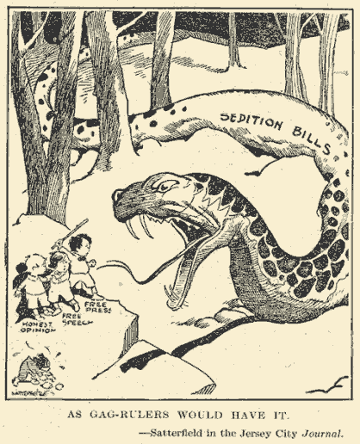
Notes:
Slides 3 and 4 show some popular opposition to the Sedition Act, which many viewed as unconstitutional—and it was repealed two years later in 1920.

Slide 4
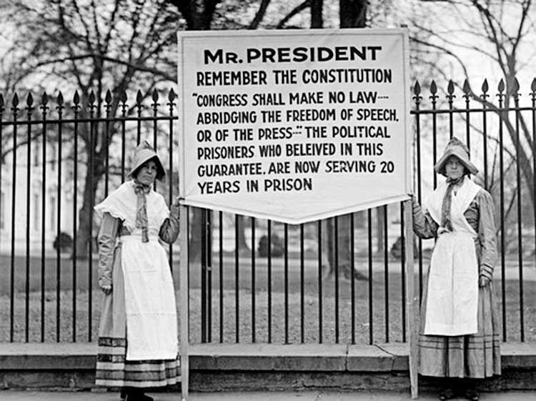
Notes:
Slides 3 and 4 show some popular opposition to the Sedition Act, which many viewed as unconstitutional—and it was repealed two years later in 1920.

Slide 5
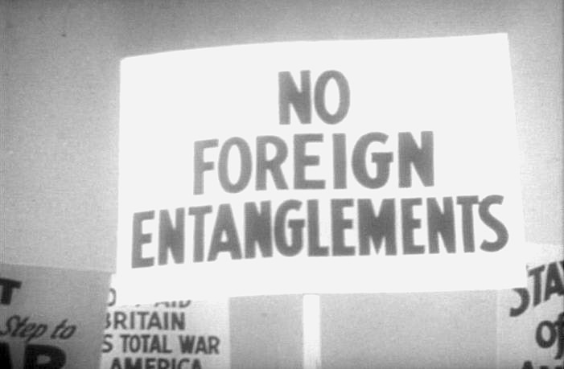
Notes:
Prior to and during World War II, opposition to the war also took the form of isolationism and non-interventionism, the idea that the U.S. had no incentive or justification to participate in a foreign war, because U.S. security was not directly threatened (see slide 5).

Slide 6
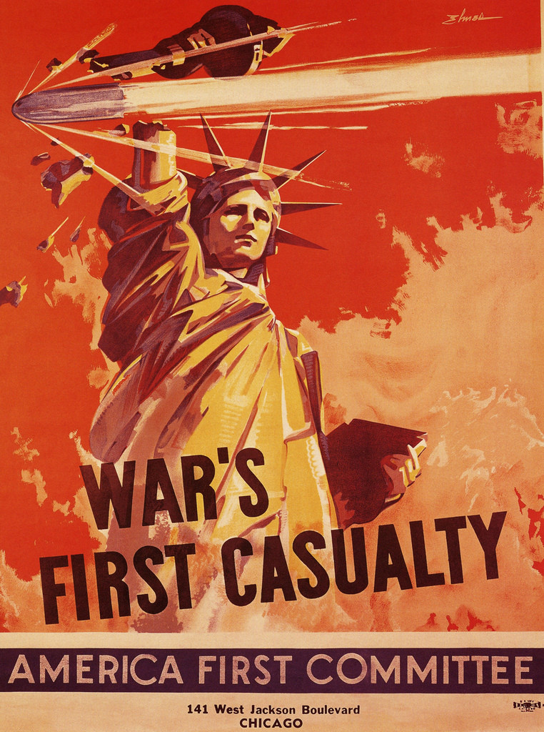
Notes:
One of the main organizations leading this anti-war movement was the America First Committee (formed in 1940), which advocated that American democracy would be weakened by participation in a European war. Take a look at the poster included on slide 6. Ask students: What message do you think this poster is trying to communicate?

Slide 7
Notes:
Play the video of Charles Lindbergh’s address to the nation on behalf of the America First Committee that is included on slide 7. Ask students: What is Lindbergh questioning or criticizing about arguments in support of U.S. involvement in the war? How would you describe Lindbergh’s tone?

Slide 8
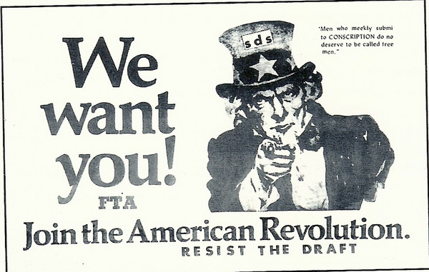
Notes:
Opposition to the war in Vietnam involved many of the same reasons that the American public had expressed in the past: a resistance to compulsory service via the draft; opposition to U.S. intervention in a foreign conflict; a right to free speech expressing disapproval for war as an immoral pursuit. There were also some reasons peculiar to Vietnam: doubts that the Vietnamese communists were properly understood as communists; fears that the United States could not achieve its goals in Vietnam at a reasonable cost; concerns that Vietnam was not important to US security interests to justify the cost of war. The face of the anti-war movement of Vietnam was young, just as it was for those who served- much of the public activism against the war was driven by college students, especially in the early phases of the conflict.
Students for a Democratic Society was a student activist group founded in 1962 that played a prominent role in the spread of campus-based anti-war activism, with over 450 chapters nationwide by 1966 (before splintering later). As with previous wars, some of the opposition to the Vietnam war expressed by SDS and others included a resistance to the draft (see slide 8

Slide 9
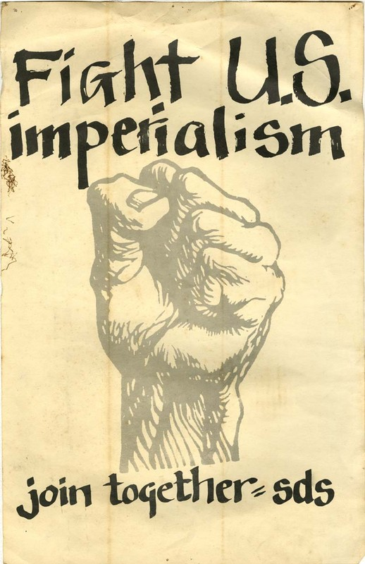
Notes:
Resistance also involved an objection to what was seen as an exercise in U.S. imperialism (see slide 9)—a resistance to becoming involved in a foreign conflict that experts would characterize as a post-colonial struggle in nation building, rather than " the simple fact that South Vietnam, a member of the free world family, is striving to preserve its independence from communist attack,” as stated in 1964 by then Secretary of Defense Robert McNamara.
(image courtesy of Steve Hudziak)

Slide 10
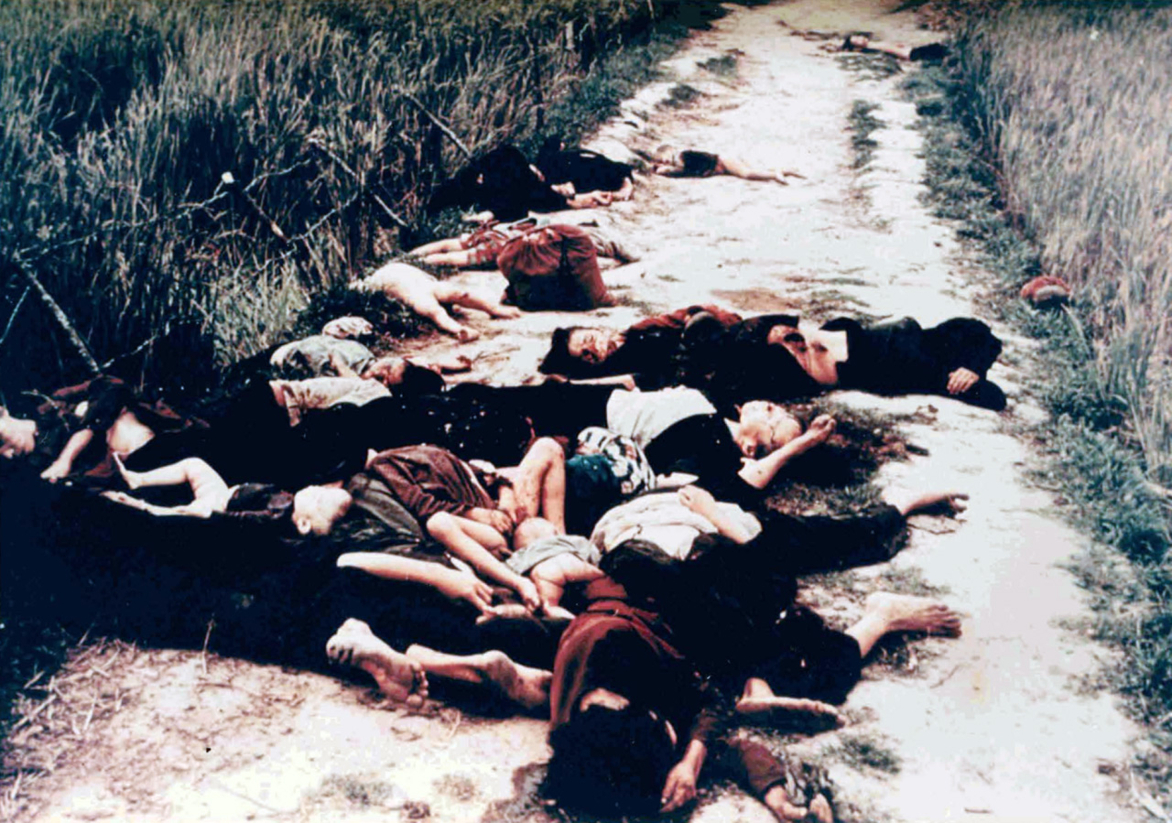
Notes:
A significant wartime change that came with Vietnam was the immediacy and arguably transparency of news coverage of the war. For the first time, American citizens were exposed to the grim realities of war, including coverage of war crimes such as the massacre of the civilians of My Lai by U.S. troops in 1968 (see slide 10 for the iconic news image). With exposure to incidents like these in the media, Americans grew increasingly disillusioned with the war (disapproval ratings reached 64% in 1970), and opposition to the war focused on the immorality and futility of U.S. operations in Vietnam. Americans could see that their government’s policy was not bringing results in either the military or political spheres. The war continued without an end in sight, and Americans began to question the government’s conduct of the conflict. Many called for an end to the conflict, whereas others demanded that the government escalate US involvement further in order to achieve the elusive victory.

Slide 11
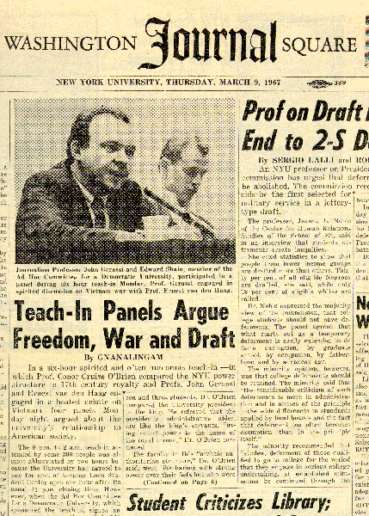
Notes:
Beginning in 1965 and onward through the duration of the war, university faculty and students around the nation responded to the increasing disapproval of the war by hosting “teach-ins,” which involved multi-day seminars on various topics relating to the war’s legality and morality (see slide 11). The teach-ins represented a non-violent means of voicing disapproval and organizing for action.

Slide 12
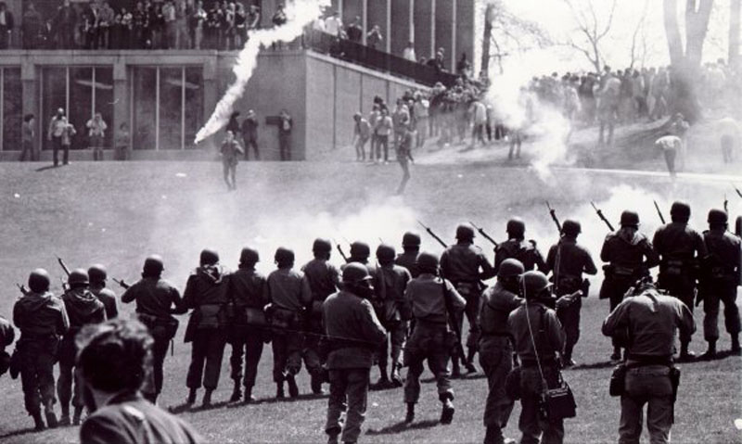
May 4 Collection. Kent State University Libraries. Special Collections and Archives.
Notes:
Perhaps the peak of the anti-war movement was seen in the shootings at Kent State University in May 1970 (see slide 12). Students at Kent State had organized to protest the US and South Vietnamese invasion into Cambodia that had been recently authorized and announced to the public by President Nixon. The protest led to the deaths of four students at the hands of the National Guard, and marked increasing public tensions regarding the war.
(Kent State University)

Slide 13
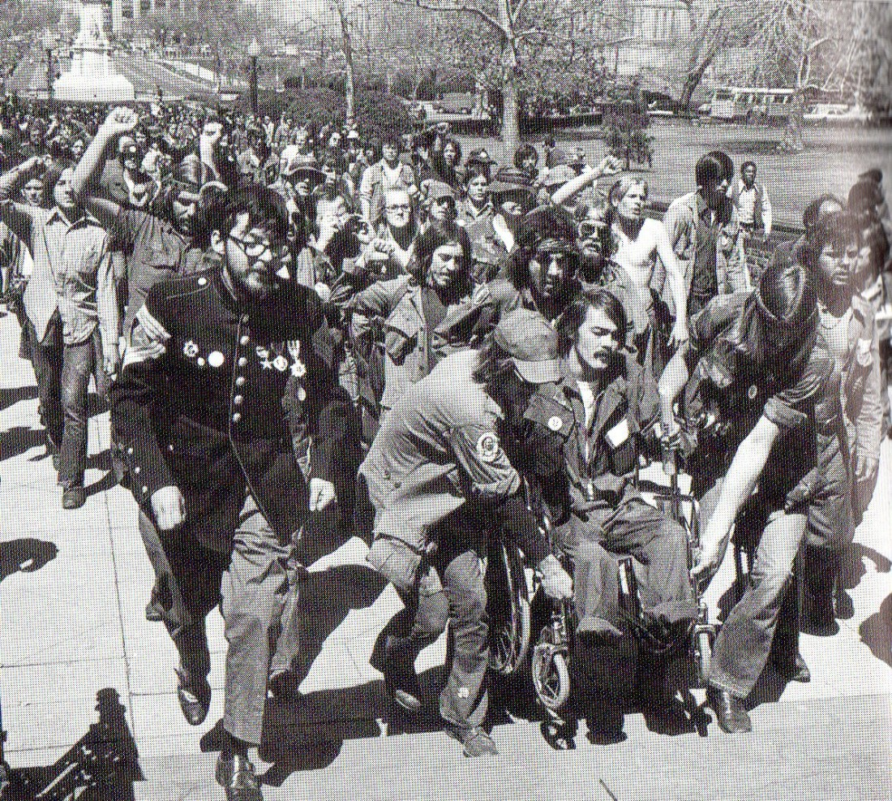
Vietnam Veterans Against the War
Notes:
In 1971, the Vietnam Veterans Against the War, an organization of returned veterans who opposed the war for various reasons, organized what is known as Operation Dewey Canyon III (see slide 13). This involved a march to the Capitol in Washington, DC, where hundreds of veterans threw their medals earned in war over the Capitol fence, in a symbolic act of opposition to the war. (VVAW)

Slide 14
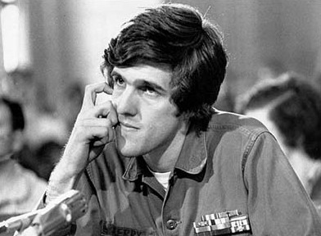
We are asking Americans to think about that because how do you ask a man to be the last man to die in Vietnam? How do you ask a man to be the last man to die for a mistake?....We are here in Washington to say that the problem of this war is not just a question of war and diplomacy. It is part and parcel of everything that we are trying as human beings to communicate to people in this country - the question of racism which is rampant in the military, and so many other questions such as the use of weapons; the hypocrisy in our taking umbrage at the Geneva Conventions and using that as justification for a continuation of this war when we are more guilty than any other body of violations of those Geneva Conventions; in the use of free fire zones, harassment interdiction fire, search and destroy missions, the bombings, the torture of prisoners, all accepted policy by many units in South Vietnam. That is what we are trying to say. It is part and parcel of everything.
1971 Vietnam Veterans Against the War statement by John Kerry to the Senate Foreign Relations Committee
Notes:
Later on, VVAW member (now Secretary of State) John Kerry testified against the war before the Senate Foreign Relations Committee. Ask students to read the excerpt of Kerry’s testimony included on slide 14. What do Kerry and VVAW cite as reasons to oppose the war?

Slide 15
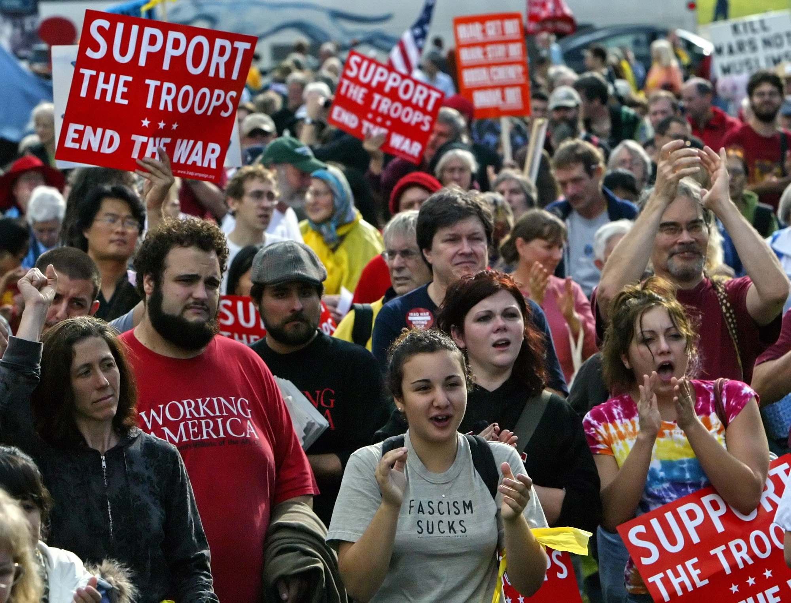
Joe Kaczmarek/Associated Press
Notes:
The legacy of the anti-war movement of Vietnam can be seen in the opposition to recent wars including the conflict in Iraq that began in 2003. On February 15, 2003, protests were staged in over 600 cities worldwide to express opposition to the impending war in Iraq, which would later be declared in March of 2003 (see slide 15). Despite the subsequent declaration of war, the February protest is considered to be the largest protest event in history thus far. In the tradition of the Vietnam era, teach-ins were also hosted by universities nationwide from 2006-2008 to educate and discuss the impacts and legality of the war in Iraq.

Slide 16
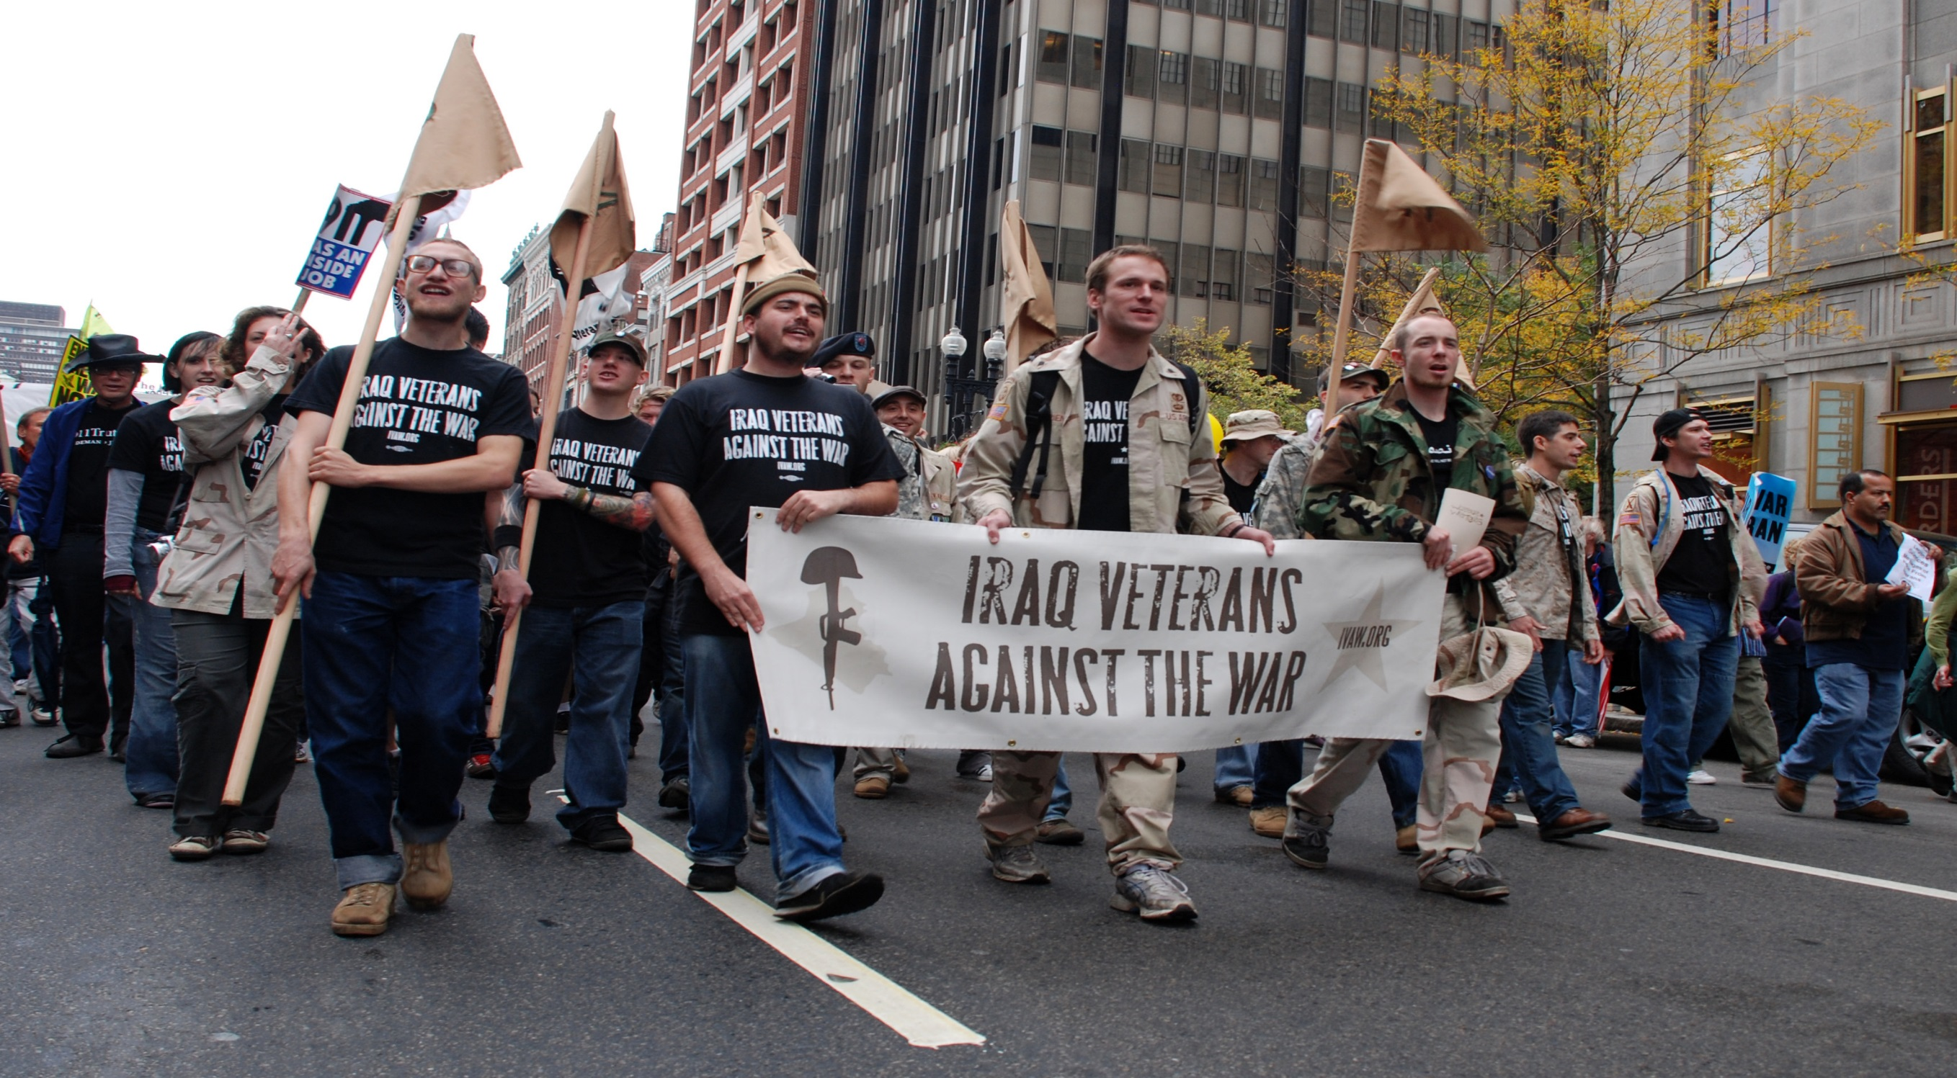
Notes:
Also following in the path of the Vietnam Veterans Against the War is the group Iraq Veterans Against the War (see slide 16), who organized chapters across the nation to voice disapproval of the 2003 war in Iraq, and who continue to be active in warning against continued operations against ISIS/Da’esh in Iraq and Syria.

Slide 17
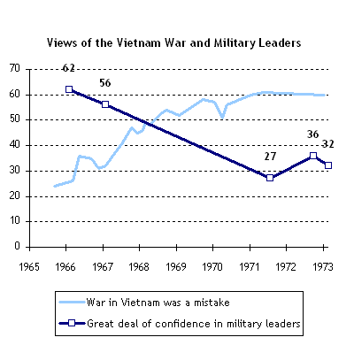
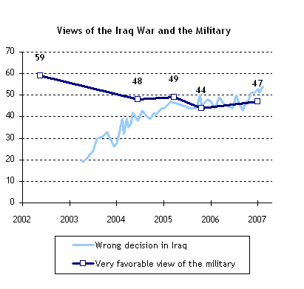
Pew Research Center
Notes:
On slide 17, ask students to compare the graph of the left (compiling data from Gallup, Harris, and NROC polls from 1966-1973), which assesses the shift in Americans’ attitudes toward the Vietnam war and toward the military, with the graph on the right (2003-2007 Pew Research polls), which assesses Americans’ attitudes toward the Iraq war and toward the military. What trends do these graphs show? Why might there have been a shift over time? Regardless of public opinion regarding any current conflict, one of the lessons of Vietnam that has persisted is the need to separate war and warrior—those who serve should be recognized for their service.

